Slide 1
Potato Leaf Disease detection using deep learning
Presented By :
1.T.Hema Sree 21BTRCD053
2.D.Pranathi 21BTRCD035
3.S.Baby Saina 21BTRCD030
4.G.Veerendra 21BTRCD038
Supervisor-
Dr A.Suresh Kumar

Slide 2
ABSTRACT
Potato cultivation faces significant challenges due to various leaf diseases that can adversely affect crop yield and quality. This study proposes a multi-model deep learning approach for potato leaf disease detection, utilizing Convolutional Neural Networks (CNN), Long Short-Term Memory networks (LSTM), and Single Convolutional Neural Networks (SCNN). The CNN classifies diseases in potato leaves based on RGB images, the LSTM analyzes temporal patterns, and the SCNN focuses on spatial features. Trained on a diverse dataset, the models are evaluated using performance metrics and compared with traditional methods, showcasing the effectiveness of deep learning. The CNN model is deployed as a user-friendly application for real-time disease prediction, enhancing practical usability in agriculture. This comprehensive approach offers a versatile solution for automated potato leaf disease detection, benefiting farmers in crop health management.

Slide 3
INTRODUCTION
Agricultural sector holds a vital role in the Indian economy by contributing 18.8% in India’s total GDP.
Potato plants covers 33% total vegetable production of India.
These production can be affected by different diseases.
Misidentification of leaf disease in the agricultural crop can lead to improper or misuse of insecticides and pesticides , causing loss of the crop, increase in pathogen resistance and environmental effect.
Machine learning technique has been used to tackle this problem.

Slide 4
OBJECTIVE
To develop a robust leaf disease detection system using multi model deep learning,
To customizing a deep learning architecture for high accuracy, by leveraging a diverse dataset for model training
To design a user-friendly interface for real-time disease identification, deploying the system at scale, ensuring continuous improvement, reducing pesticide use, and promoting sustainability through collaboration with agricultural stakeholders.

Slide 5
Problem Statement
Farmers who grow potatoes suffer from serious financial standpoint losses each year which cause several diseases that affect potato plants.
The diseases Early Blight and Late Blight are the most frequent.
Early blight is caused by fungus and late blight is caused by specific micro-organisms and if farmers detect this disease early and apply appropriate treatment then it can save a lot of waste and prevent economical loss.
The treatments for early blight and late blight are a little different so it’s important that you accurately identify what kind of disease is there in that potato plant.

Slide 6
Literature review
S.NO | Author | Year | Title of Paper | Proposed Method | Limitations
1. | Zhang, S.You, Z., & Wu, X. | 2019 | Plant disease leaf image segmentation based on super pixel clustering and EM algorithm | Accuracy is about 90% and has high practical value for plant disease detection | It does not provide any expert’s advice for remedial measures about the diseases
2. | Ashqar B. A., & AbuNAser S.S. | 2018 | Image based tomato leaves diseases detection using deep learning | Accuracy is about 80% on finding the crop diseases | Implementation is based on the online. No remedial measures are suggested for the diseases

Slide 7
Literature review
3. | Ferentinous K.P. | 2018 | Using deep learning image based plant disease detection | It is very useful advisory or early warning tool to operate in cultivation Accuracy is about 95% | It does not provide any remedial measures to the user.
4. | Tran, Thao et al | 2021 | Plant Disease Detection and Classification by Deep Learning | Modeling complex processes and performing pattern recognition in applications with large amount of data | The entire photographic material included solely images in experimental (laboratory) setups, not in real conditions in the cultivation field
5. | Sladojevic et al. | 2018 | Recognition of plant diseases by leaf image classification." | The model achieved high accuracy, demonstrating the potential of CNNs in plant disease detection. | The visual symptoms of different diseases can be similar, making accurate detection difficult even for experts..

Slide 8
Existing system
Super Pixel Clustering and EM Algorithm : This method involves plant disease leaf image segmentation, which achieves about 90% accuracy. However, it lacks expert advice on remedial measures for the diseases detected.
Deep Learning for Tomato Leaf Disease Detection: This approach focuses on detecting tomato leaf diseases using deep learning, with an accuracy of around 80%. The implementation is online-based and does not offer suggestions for remedies.
Plant Disease Detection by Deep Learning: This method involves modeling complex processes and pattern recognition using deep learning. The photographic material is mostly experimental and not in real cultivation conditions.

Slide 9
Drawbacks
1.Data Dependency: High accuracy in deep learning models often depends on large, annotated datasets. Collecting and labeling potato leaf images can be time-consuming and costly, especially for different growth stages, conditions, and diseases.
2.Generalization Issues: Models trained on specific datasets may struggle to generalize across different environments, such as varying lighting conditions, backgrounds, or potato leaf varieties. This can lead to reduced accuracy in real-world scenarios.
3.Computational Resources: Training deep learning models requires substantial computational power, including GPUs, and can be resource-intensive, which might not be feasible for all researchers or farmers.
4.Complexity and Interpretability: Deep learning models, especially deep neural networks, are often considered "black boxes." This lack of interpretability can be problematic when trying to understand why a model made a certain prediction, which is important in agricultural contexts.
5.Overfitting: Without careful management, deep learning models can overfit to the training data, meaning they perform well on the training set but poorly on unseen data. This is especially a risk with small or imbalanced datasets.

Slide 10
Proposed method
The proposed method combines several advanced techniques: Convolutional Neural Networks (CNN)are employed for accurate image classification, identifying various leaf diseases based on visual patterns. Long Short-Term Memory (LSTM) networks are integrated to analyze temporal patterns, offering insights into how diseases progress over time. Additionally, the Single Shot Multi-box Detector (SSD)is utilized for real-time object detection, allowing the system to quickly and efficiently identify affected areas on the leaf. This comprehensive approach aims to surpass the limitations of existing methods by providing higher accuracy, real-time application, and actionable insights for managing potato leaf diseases.

Slide 11
Advantages of proposed method
Higher Accuracy: By combining CNN, LSTM, and SSD models, the method leverages the strengths of each to improve overall detection accuracy, reducing false positives and false negatives compared to single-model approaches.
Real-Time Detection: The use of the Single Shot Multi-box Detector (SSD) allows for real-time identification of diseased areas on potato leaves, enabling quick responses in agricultural settings.
Temporal Analysis: The integration of LSTM networks allows for the analysis of disease progression over time, providing insights that can help in early detection and timely intervention.

Slide 12
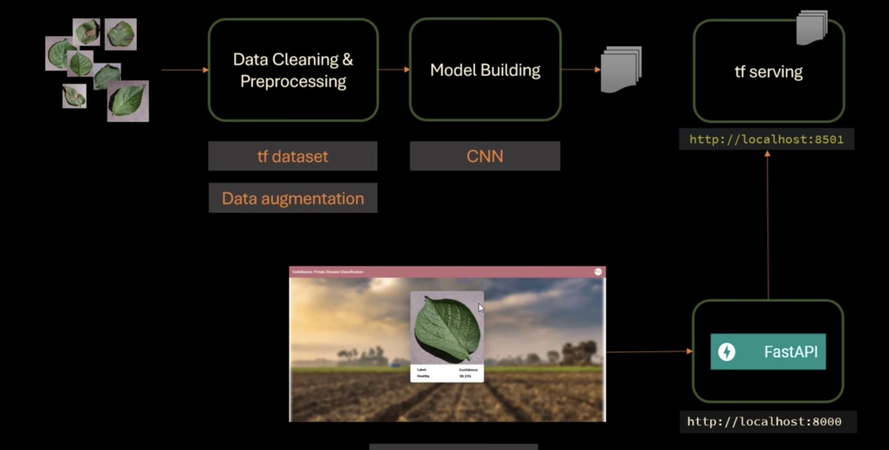
ARchitecture

Slide 13
Algorithm
1. Convolutional Neural Networks (CNN):
Image Feature Extraction: CNNs are used to extract spatial features from potato leaf images by applying convolutional layers. These features capture edges, textures, and patterns that help distinguish healthy and diseased plants.
Disease Localization: CNNs can focus on regions of interest (e.g., disease spots or lesions) by using filters and pooling operations, helping the model to detect specific diseases based on visual characteristics.
2. Spectral Convolutional Neural Networks (SCNN):
Multi-Spectral Image Analysis: SCNNs extend CNNs to work on multi-spectral or hyper-spectral images, capturing information beyond the visible spectrum (e.g., infrared). This is useful for identifying subtle disease markers in potato crops that might not be visible in standard RGB images.
Spectral Data Integration: SCNNs combine spectral data from different wavelengths with spatial features, improving the overall accuracy of disease classification by leveraging both spatial and spectral information.
3. Long Short-Term Memory (LSTM):
Temporal Data Handling: LSTMs are useful when classifying diseases in potato crops over time, especially in time-series data such as disease progression captured by drones or field sensors. They can model sequential dependencies and trends in disease symptoms.
Contextual Information: LSTMs help track the progression of a disease in potato plants, learning patterns from a series of images or data points to provide a more robust diagnosis by considering how symptoms evolve.

